Slide 1

Communication System IICT Lecture 10

Slide 2
What is Communication?
Notes:
Act of transferring information from one place to another

Slide 3
Characteristics of Communication System
There must be a Sender and Receiver
A protocol is a set of rules which governs the transfer of data between computers. Protocols allow communication between computers and networks.
Handshaking is used to establish which protocols to use. Handshaking controls the flow of data between computers
Protocols will determine the speed of transmission, error checking method, size of bytes, and whether synchronous or asynchronous

Slide 4
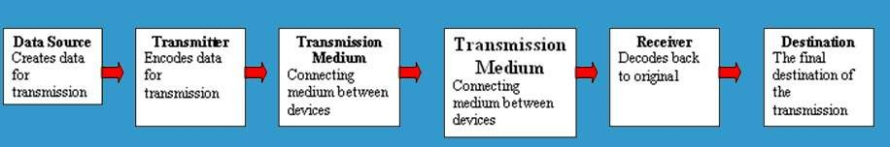
Five Basic Components
Every communication system has 5 basic requirements
Data Source (where the data originates)
Transmitter (device used to transmit data)
Transmission Medium (cables or non cable)
Receiver (device used to receive data)
Destination (where the data will be placed)

Slide 5
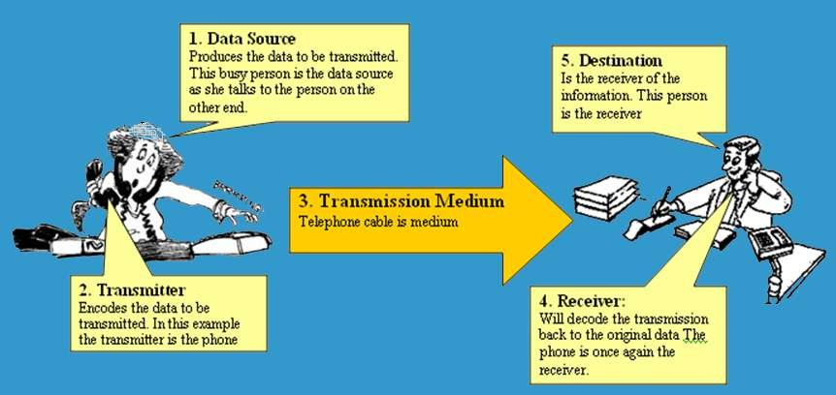
Pictorial Representation

Slide 6
OSI Model
The Open Systems Interconnection model (OSI model) is a conceptual model that characterizes and standardizes the communication functions of a telecommunication or computing system without regard to its underlying internal structure and technology.
The OSI model also provides much more information which is included with each package.

Slide 7
7 Layers of OSI Model
OSI “Open System Interconnection”
OSI is not a protocol but a list of protocols divided between 7 layers with each layer having a different set of functions.
Each packet is layered/packaged with protocols from each of the layers as it is processed.
The process of layering the protocols around each package is called encapsulation. The final encapsulated data packet is called a frame.

Slide 8
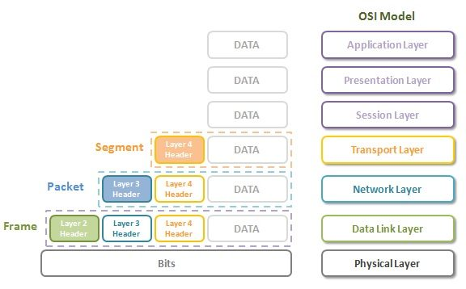
OSI Model

Slide 9
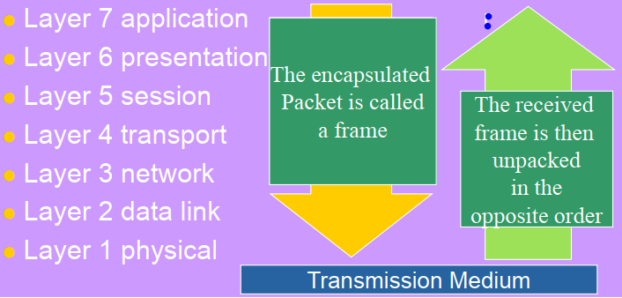
OSI Model
OSI Reference Model

Slide 10
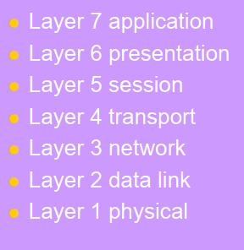
Service Performed at Each Layer
Identification, authentication
Format conversion
Set-up coordinate conversation
Ensures error-free transfer
Routing of data through network
Error control and synchronization
Placing signals on the carrier

Slide 11
Service Performed at Each Layer
E-mail, Web browser, Directory
POP, SMTP, FTP, HTTP, DNS
Sockets
TCP
IP
PPP, Ethernet, Token ring
100baseT

Slide 12
Transmitting and Receiving in Comm. Systems

Slide 13

Serial Transmission
Data is transmitted, on a single channel, one bit at a time one after another
Much faster than parallel because of way bits processed (e.g. USB and SATA drives)

Slide 14
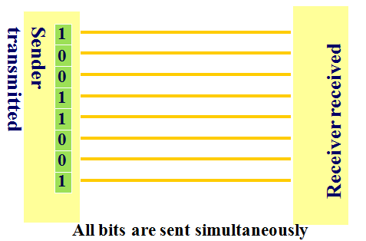
Parallel Transmission
Each bit has it’s own piece of wire along which it travels
Often used to send data to a printer

Slide 15
Why not to use Parallel instead Serial?
Due to inconsistencies on channels data arrives at different times
Because of the way it is transmitted packet switching cannot be used
The above two points makes parallel slower than serial and requires higher bandwidth.
Parallel transmissions are rarely used anymore

Slide 16
Synchronous VS Asynchronous Transmission
Synchronous Transmission
All data sent at once and no packet switching
Asynchronous Transmission
Uses stop/ start bits
most common type of serial data transfer
Allows packet switching
Allows sharing of bandwidth (i.e. talk on phone while another person is using internet)

Slide 17
Transmission Directions
Simplex: One direction only
Half duplex: Both directions but only one direction at a time
Full duplex: send and receive both directions at once

Slide 18
Network Topologies
Mesh Topology
Ring Topology
Bus Topology
Star Topology

Slide 19
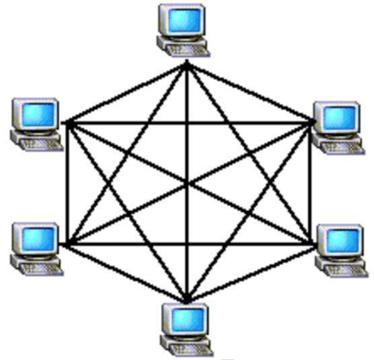
Mesh Topology

Slide 20
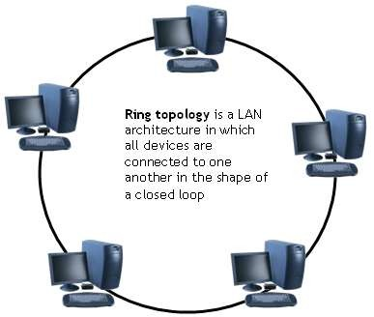
Ring Topology

Slide 21
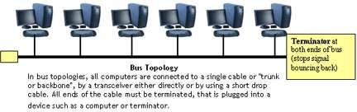
Bus Topology

Slide 22
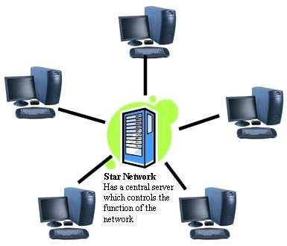
Star Topology

Slide 23
Network Hardware

Slide 24
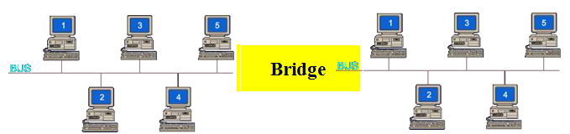
Bridge
Large networks can be separated into two or more smaller networks using a bridge. This is done to increase speed and efficiency. This type of network is called a segmented LAN and has largely been superseded by the use of switches which can transfer data straight to a computer and thus avoid bottleneck jams which bridges were designed to fix.

Slide 25
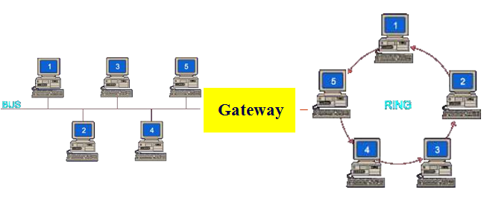
Gateway
Often used to connect a LAN with a WAN.
Gateways join two or More different networks together.

Slide 26
Some more
Routers: A router is a networking device that forwards data packets between computer networks. Can be used in place of a switch or bridge.
Switches: smart hubs which transmit packets to the destination port only
Hubs: like double adapters /power boards in the home except instead of plugging in extension cords we are plugging in computers to allow them to communicate.

Slide 27
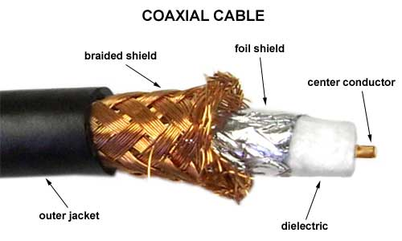
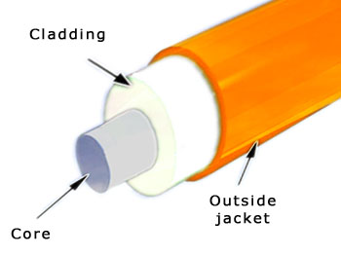
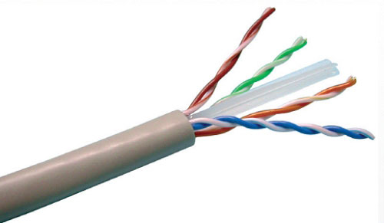
Transmission Media
Twisted pair – Ethernet cable
Coaxial cable –Thick black cable used for higher bandwidth communications than twisted pair (i.e. Optus cable)
Fiber optic – data transferred through pulses of light. Extremely fast.
Non cable methods such as satellite, microwave, wireless and Bluetooth

Slide 28
End of the Lecture

